Slide 1
The Battle of Neighborhoods
CAPSTONE PROJECT PRESENTATION

Slide 2
INTRODUCTION
The main objective of this project is to help people in exploring better facilities around their neighborhood.
It will help people in making a smart and efficient decision on choosing excellent neighborhoods out of numbers of other neighborhoods in Scarborough, Toronto.
This project intends to create an analysis of features for people who are migrating to Scarborough in search of the best neighborhood as a relative analysis between neighborhoods.

Slide 3
PROBLEM STATEMENT
The major goal of this project is to recommend a better neighborhood in a new city for the person who is moving there. Social presence in society in terms of like-minded people.
Connectivity to the airport, bus stand, city center, markets and other daily needs things nearby.
1) Sorted list of the house in terms of housing prices in an ascending or descending order
2) Sorted list of schools in terms of location, fees, rating, and reviews

Slide 4
Data
DataLink: https://en.wikipedia.org/wiki/List_of_postal_codes_of_Canada:_M
Will use Scarborough dataset which we scrapped from wikipedia on Week 3. Dataset consisting of latitude and longitude, z
The data retrieved from Foursquare contained information of venues within a specified distance of the longitude and latitude of the postcodes. The information obtained per venue as follows:
1.Neighborhood 2.Neighborhood Latitude 3.Neighborhood Longitude 4.Venue 5.Name of the venue e.g. the name of a store or restaurant 6.Venue Latitude 7.Venue Longitude 8.Venue Category 9.ip codes.

Slide 5
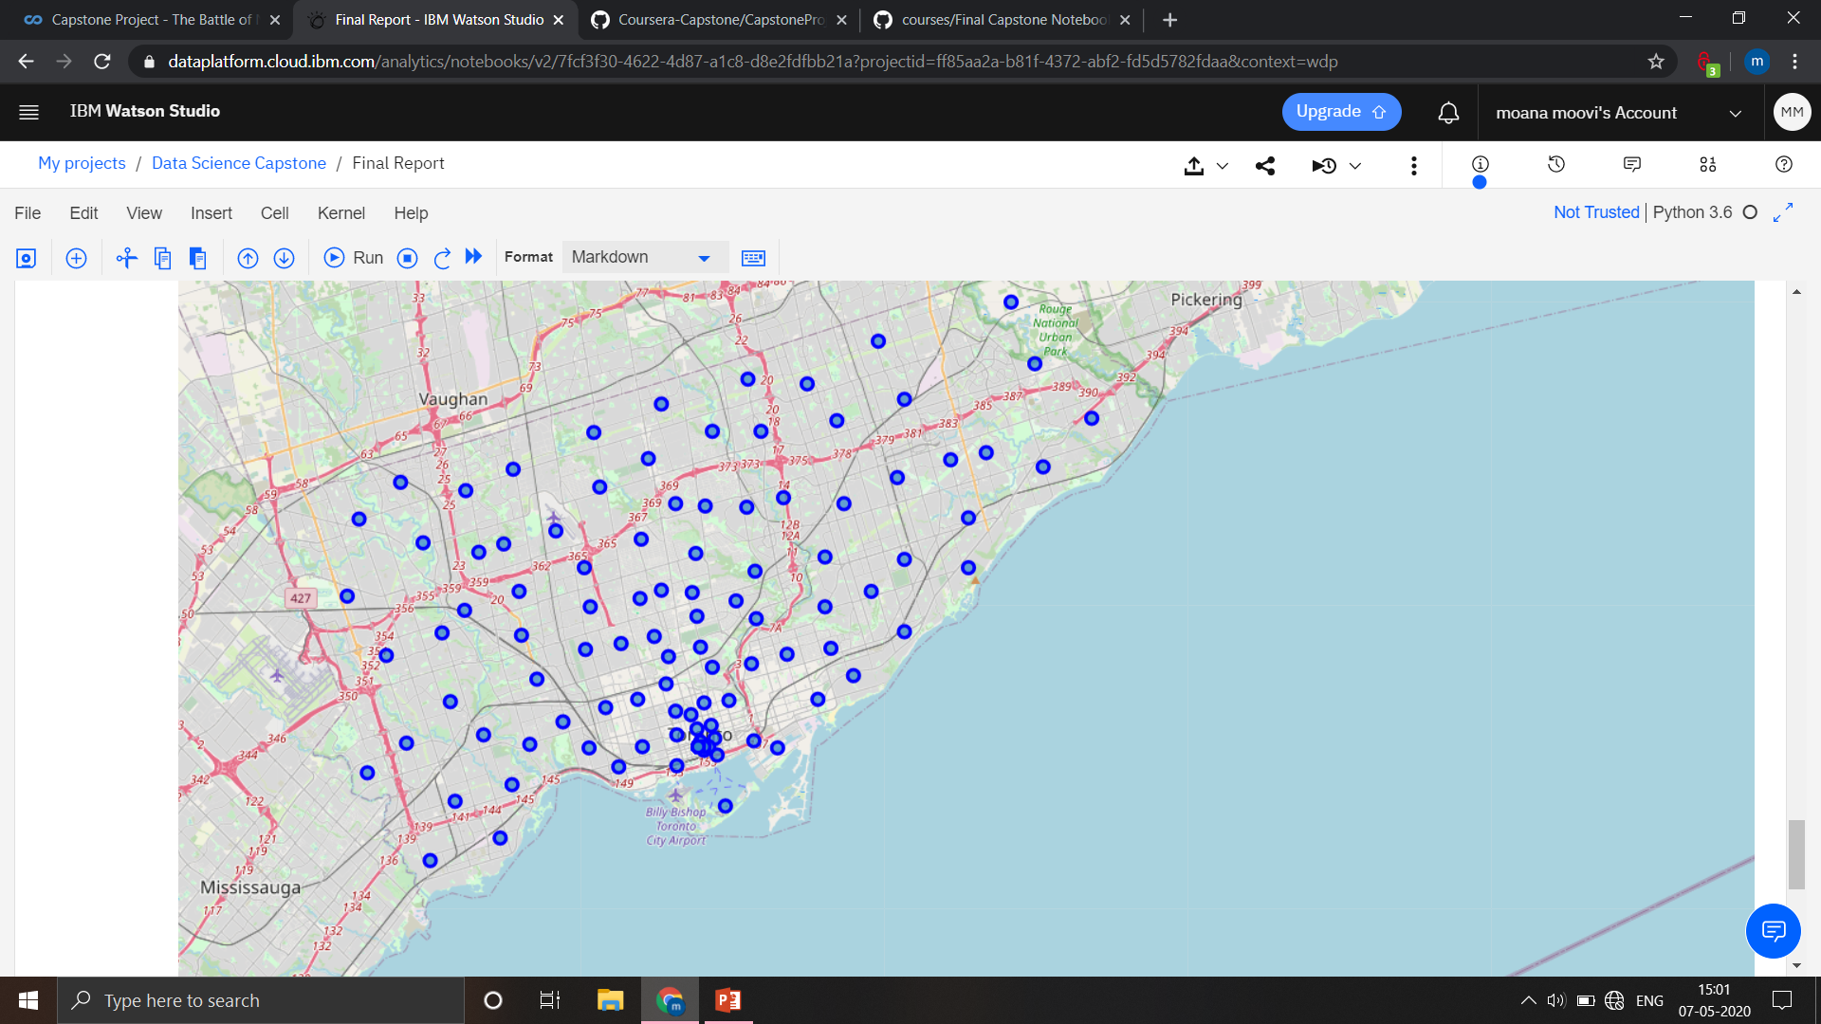
Map of Scarborough
The Geograpical Co-ordinate of Seattle,Washington are 43.773077, -79.257774.

Slide 6
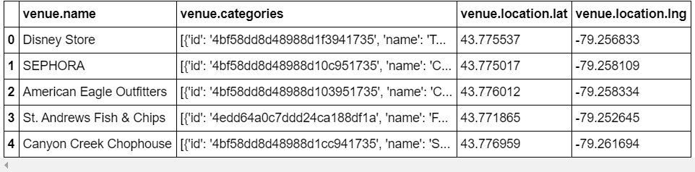
Nearby Venues/ Locations

Slide 7
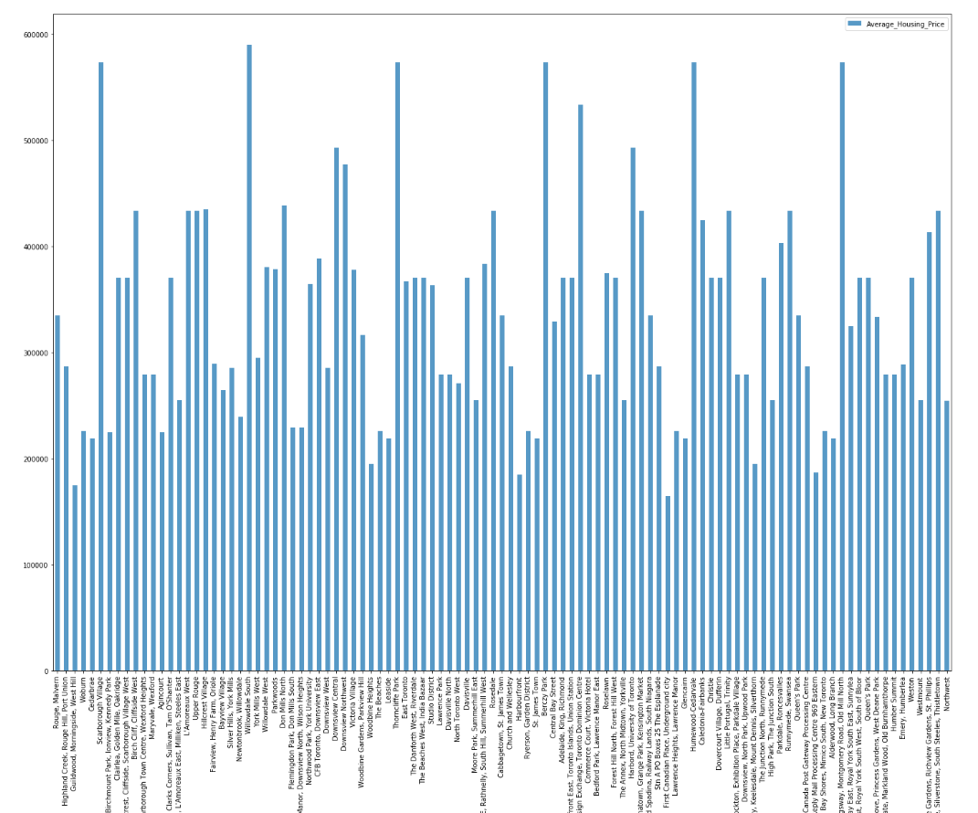
Nearby Venues/ HOUSE PRICE

Slide 8
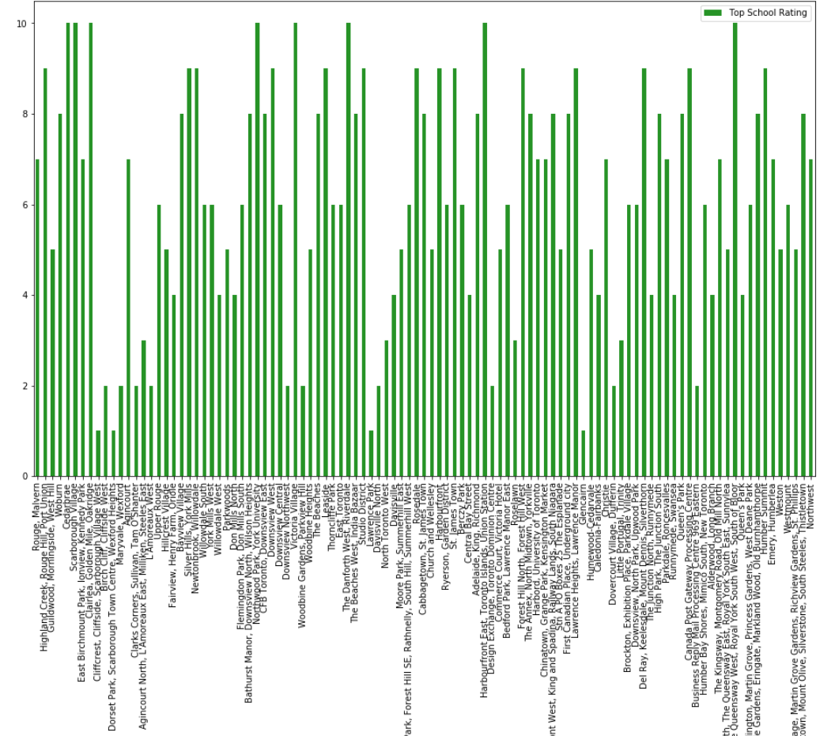
SCHOOL RATING

Slide 9
Conclusion
In this project, using k-means cluster algorithm I separated the neighborhood into 10(Ten) different clusters and for 103 different lattitude and logitude from dataset, which have very-similar neighborhoods around them.
Using the charts above results presented to a particular neighborhood based on average house prices and school rating have been made.

